Slide 1
KICK OFF MAGUS PROJECT BR
July 2023
Acer Brazil
ACER CONFIDENTIAL

Slide 2
Project Information

Slide 3
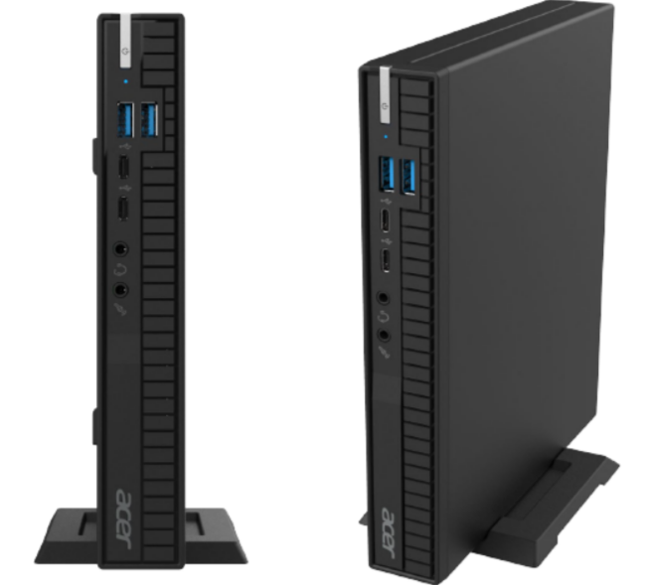
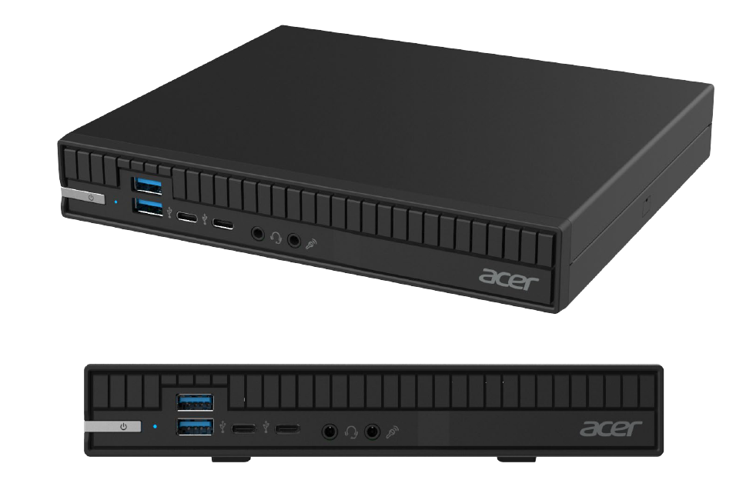
B2B Market in Brazil
ODM: ECS
ODM Project Name: SF110-B660
Acer Project Name: Magus
Market Name: Veriton 4000 Mini
Projet BOM Name: VSF110_E
Category: Mini Desktop – Tiny 1.1lts
Production: Local Production in Brazil
Design

Slide 4

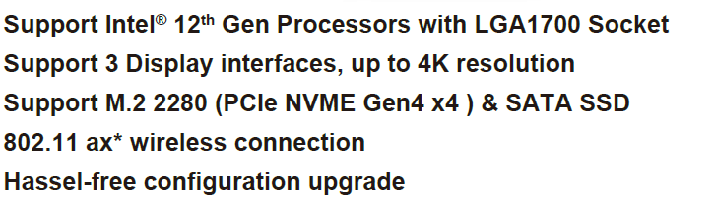
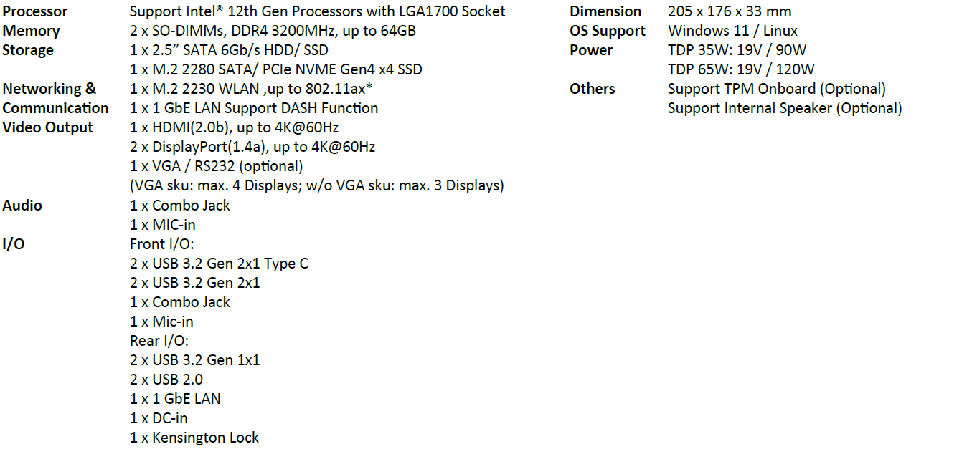
Magus Project- Spec Details

Slide 5
NPI Schedule and Production Plan

Slide 6
Magus Project- Production Plan
MOQ to no Tooling Cost: 15k
Ps. Potential Production quantiy increase in future
NPI: Second Half of November 200 units, delivery 200 units in December
Production Plan
Product | Project | CPU | Memory | SSD | OS | GPU | Q4'23 | Q1'24 | Q2'24 | Q3'24 | Q4'24 | Total
Mini Destop | Magus | core i3T | 8GB | 256GB | WINPRO | UMA | 0 | 500 | 500 | 500 | 500 | 2.000
Mini Destop | Magus | core i5T | 8GB | 512GB | WINPRO | UMA | 200 | 2.000 | 3.000 | 3.000 | 3.000 | 11.200
Ps. Project Magus Production without keyboard, mouse and painel

Slide 7
Supplier Strategy

Slide 8
Material Strategy
Suppliers
Material FOB | Supplier
CPU’s | Acer
Adapter 90W | Acer
WIFI + BT | Acer
KIT CKD and SKD | ECS
Local Material | Supplier 1 | Supplier 2
Memory | Adata | Hana
Adapter 90W |  | Lite On
SSD | Hana | Adata
Package | La Rondine
MB | FBR Manaus
Ps. CPUs join Motherboards in Manaus, Jundiaí will receive the MBs with CPU installed, credit strategy to reduce the product cost.

Slide 9
Potential Customers

Slide 10




Rental and BID’s
Project started to meet the Acer Rental
Initial Production Quantity: 15K unit by year (1250 units per month)
High potential on Rental and B2B ( governament and corporate sales) and increase quantity for producing
Tiny Desktops are commonly used in Call Centers due to an ergonomic law from Brazilian Government (NR17).
We have BIDs opportunities for those devices but to have a complete solution on Rental we need to have it available on the portfolio. Most of big companies has Call Center and they open BIDs for complete solution which means that if we don’t have the solution, we can lose opportunities in Notebooks, Monitors and others.
Currently we have some opportunities opened as below:
Banco do Brasil- Governament Purchasing BID with 20k opened opportunity to deliver in 2023 with a Business Partner.
New BID for supply in 2024 will be opened soon.
BIOS Customization as: Customer Serial Control 13 digits, change Wallpaper and Auto diagnoses.
Rental BID opened currently. Havan das 190 shops with about 50 mini desktops required per shop.
Rental BID opened currently. 1000 desktops units + 900 Monitors and 100 notebooks
Rental BID opened currently. 450 desktops units + 450 Monitors + accessories

Slide 11
Contac Window

Slide 12

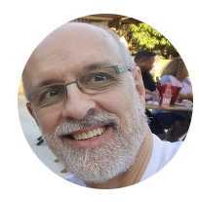





Contact Window
Contact Window
Nome | Company | Function | Phone | Email
Gerardo | Acer | Operation Director | 5511964974782 | alexandre.gerardo@acer.com
Luiz Magoga | Acer | Project Leader and Quality Engineer | 5511964040527 | luiz.magoga@acer.com
Luiz Gonzaga | Acer | Services Director | 5511999577705 | luiz.gonzaga@acer.com
Gloria Shyu | Acer | Full Filment | 5511981448233 | gloria.shyu@acer.com
Maisa Castelano | Acer | Materials |  | maisa.castelhano@acer.com
Davi Vital | Acer | Procurement Manager | 5511986941407 | davi.vital@acer.com
Cristiane Ramos | Acer | Senior Product Manager | 5511968441836 | cristiane.ramos@acer.com
Milton Junior | Acer | Product Manager | 5511982463084 | milton.junior@acer.com
André Teixeira | Acer | Product Business Manager | 5511988823209 | andre.teixeira@acer.com
Roberto Cabrera | Acer | Finantial Director | 5511993376142 | roberto.cabrera@acer.com
Wesley Oliveira | Acer Services | Services Manager | 5511987790969 | wesley.oliveira@acer.com
João Moraes | Acer Services | Services Supervisor |  | joao.morais@acer.com
Charles | Acer | Product Technian Specialist |  | charles.machado@smollanitrade.com.br
Francisco Dardi | ESC | ECS Sales Contact Suport | 5511999338809 | francisco.dardi@ecsbrasil.com
André Teixeira
Business Sr. Manager,
Milton Junior
Product Manager
João Moraes
Services Supervisor
Luiz Gonzaga
Services Director
Cristiane Ramos
Sr. Product Manager
Francisco Dardi
ECS - Contact Suport
Wesley Oliveira
Services Manager

